Slide 1
NBA Player Positions
Jason Katz
Brown University
October 22, 2019
github.com/jasonk33/nba-player-positions

Slide 2
Intro
Understand difference between NBA positions
There are 5 positions in the NBA (point guard, shooting guard, small forward, power forward, and center).
This is a classification task, predicting a player’s position based on their seasonal statistics
Data was scraped from basketball-reference.com

Slide 3
Preprocessing
Most of the features were continuous, so either standard or minmax scaling was applied
One hot encoding was applied to the single categorical feature
The label had multiple values, so a label encoder was used
After preprocessing, there were 22 features and round 10,000 data points

Slide 4
Preprocessing
For the labels, almost every player has one of the 5 main position designations (PG, SG, SF, PF, C), but a select few players are listed under multiple positions
Since the number of players listed under multiple positions is small, those were removed from the dataset

Slide 5
Preprocessing
Players who were traded during the season, were listed more than once, with statistics for each team they played for, as well as their total stats combined for the year
For players that were traded, the rows representing their total stats combined for both teams were kept, and the other rows for them were removed

Slide 6
Preprocessing
There were some missing values for field goal percentage statistics when a player had not attempted any shots
Since field goal percentages can be calculated directly from field goal makes and attempts, the percentage features were removed

Slide 7
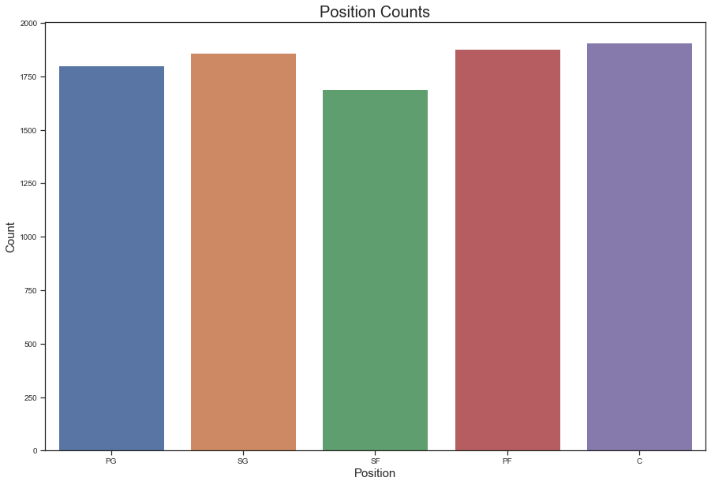
EDA

Slide 8
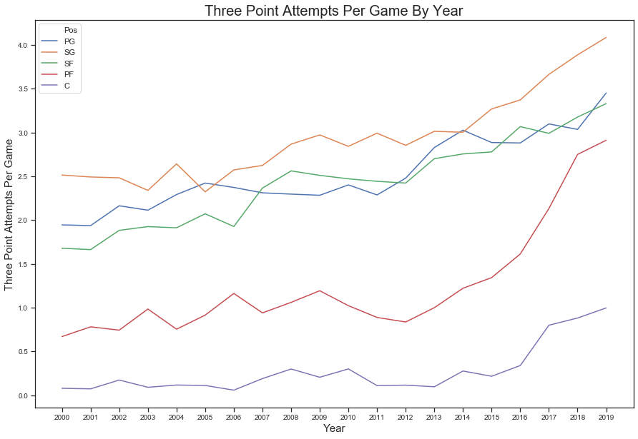
EDA

Slide 9
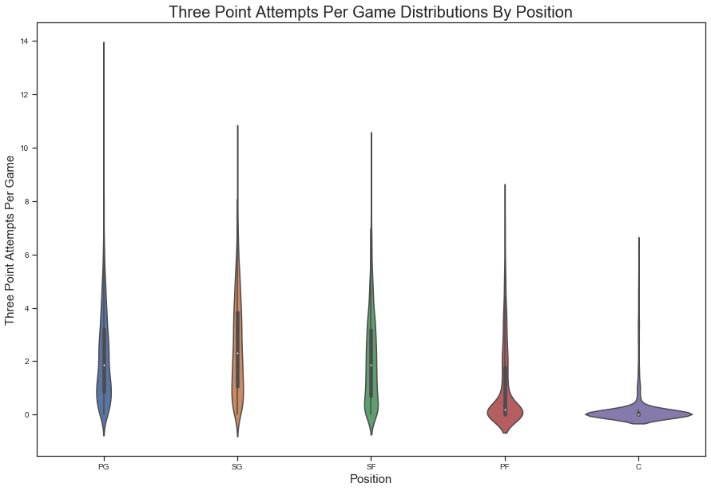
EDA

Slide 10
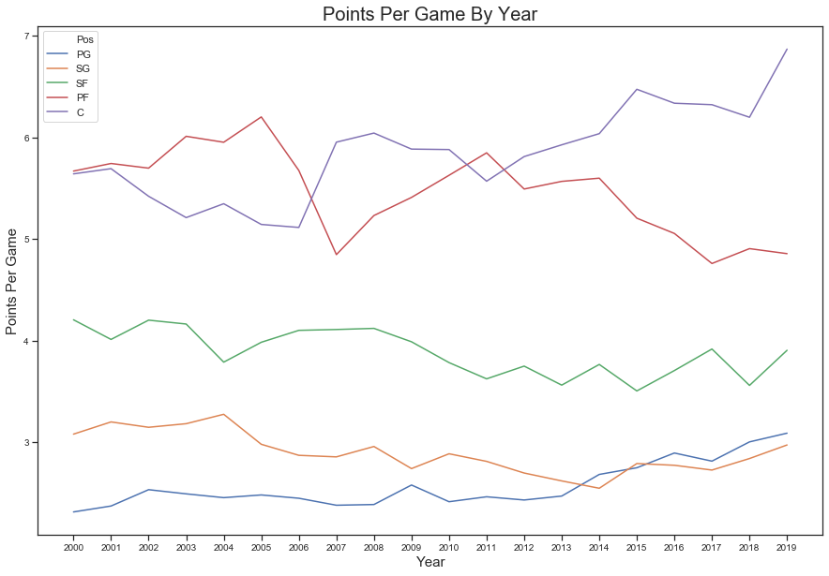
EDA

Slide 11
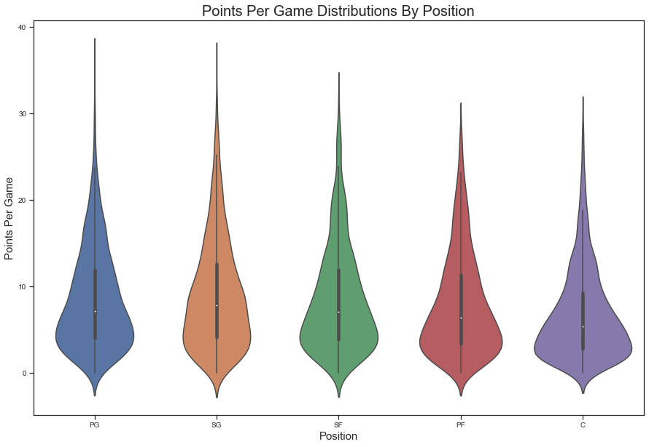
EDA

Slide 12
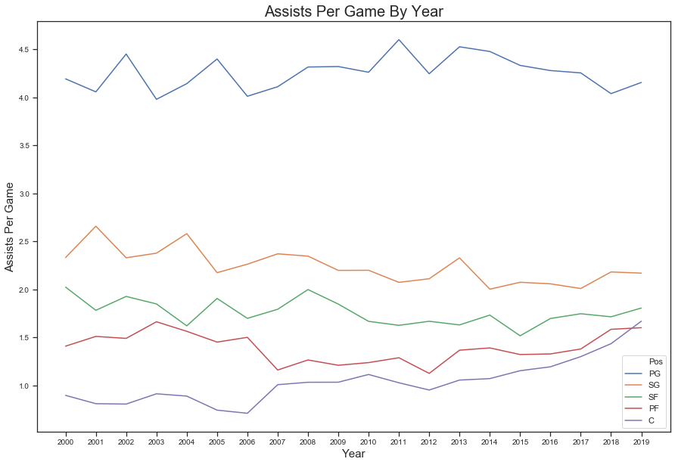
EDA

Slide 13
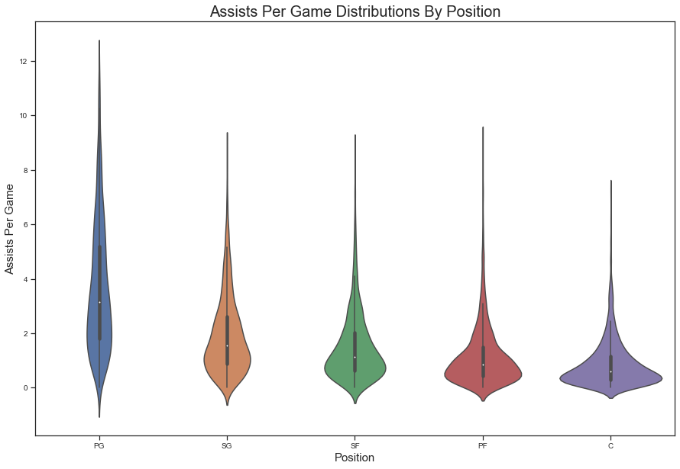
EDA

Slide 14
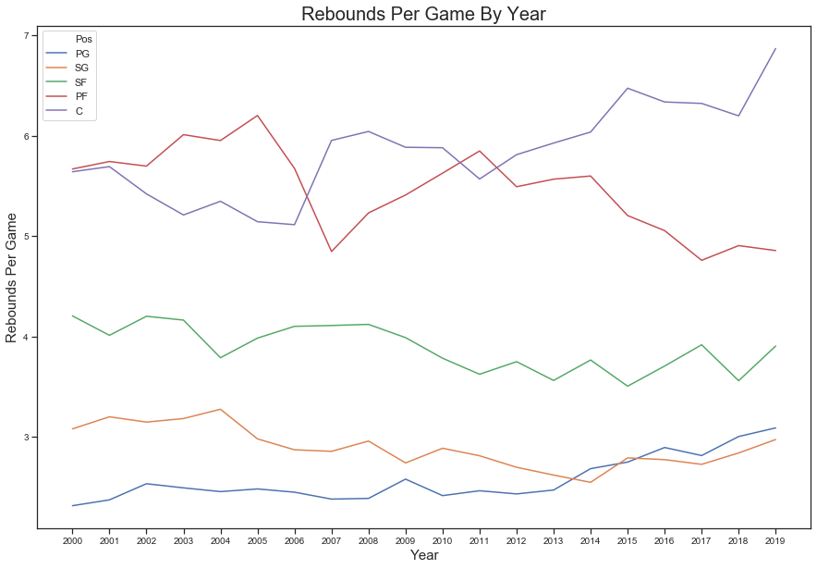
EDA

Slide 15
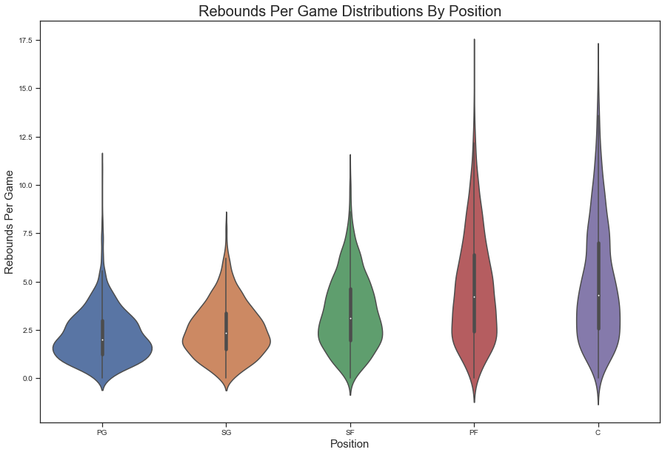
EDA

